Slide 1

Pizza Sales Analysis
SQL Project
By Sanjana John

Slide 2



This presentation provides a comprehensive analysis of the the data from the Pizza Ordering System which has been extracted, manipulated and analyzed using MySQL.
Our database “pizzahut” consists of four interconnected tables: pizzas, pizza_types, orders and order_details.
Queries had been designed and executed to :
Aggregate data for meaningful insights
Calculate key metrics such as revenue and order quantities
Identify trends and patterns in pizza orders

Slide 3

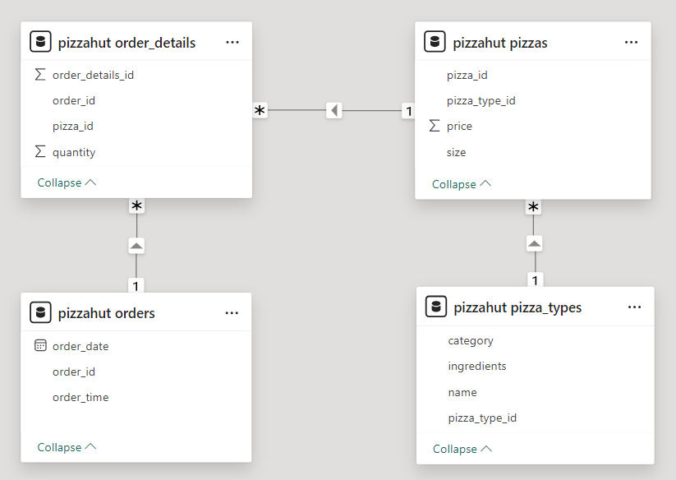
Table Relationships

Slide 4
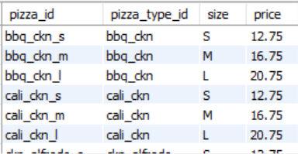
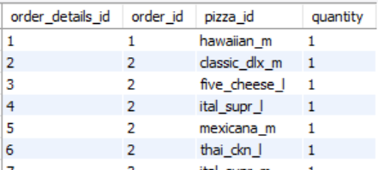

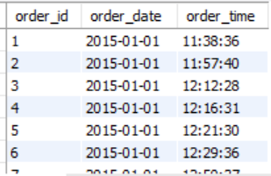
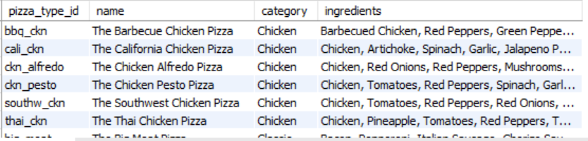

Table Details & Relationship
Orders_details
Pizzas
Order
Pizza_types

Slide 5
Queries
Retrieve the total number of orders placed.
Calculate the total revenue generated from pizza sales.
Identify the highest-priced pizza.
Identify the most common pizza size ordered.
List the top 5 most ordered pizza types along with their quantities.
Join the necessary tables to find the total quantity of each pizza category ordered.
Determine the distribution of orders by hour of the day.
Join relevant tables to find the category-wise distribution of pizzas.
Group the orders by date and calculate the average number of pizzas ordered per day.
Determine the top 3 most ordered pizza types based on revenue.
Calculate the percentage contribution of each pizza type to total revenue.
Analyze the cumulative revenue generated over time.
Determine the top 3 most ordered pizza types based on revenue for each pizza category.

Slide 6
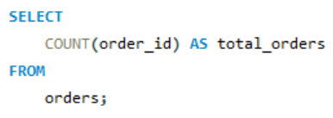

Retrieve total numbers of orders placed

Slide 7
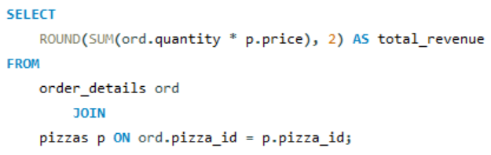

Calculate total revenue generated from pizza sales.

Slide 8
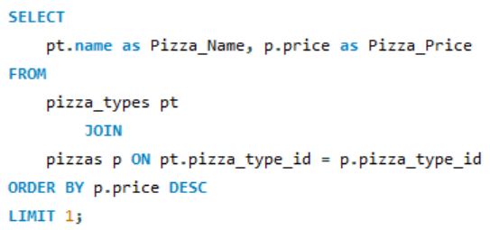

Identify the highest priced pizza

Slide 9
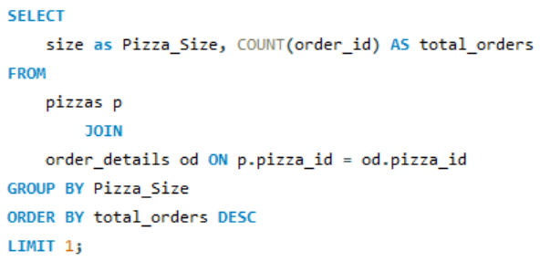

Identify the most common pizza size ordered.

Slide 10
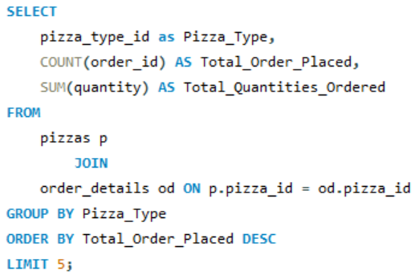
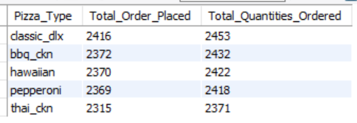
List the top 5 most ordered pizza types along with their quantities.

Slide 11
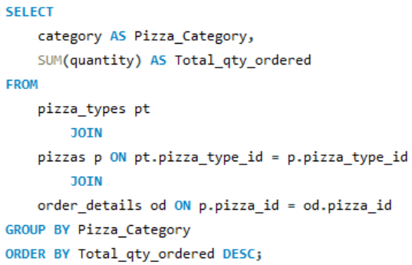
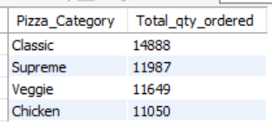
Join the necessary tables to find the quantity of each pizza CATEGORY ordered

Slide 12
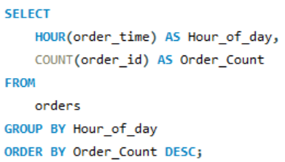
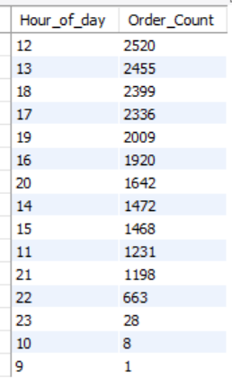
Determine the distribution of orders by hour of the day.

Slide 13
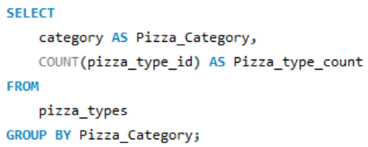
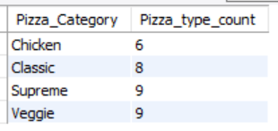
Join relevant tables to find the category-wise distribution of pizzas.

Slide 14
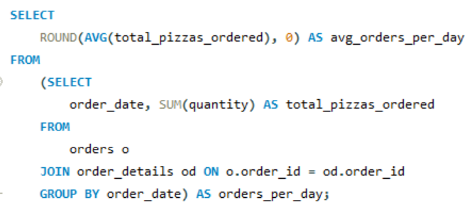

Group the orders by date and calculate the average number of pizzas ordered per day

Slide 15
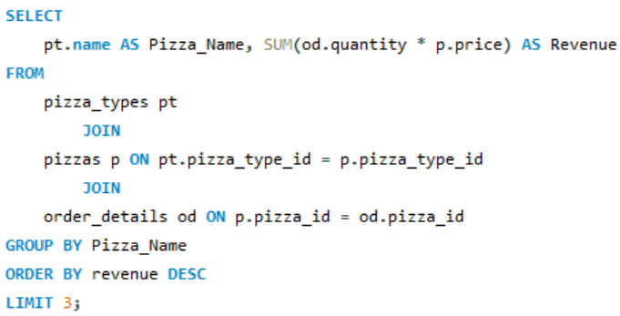
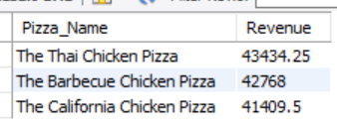
Determine the top 3 most ordered pizza types based on revenue.

Slide 16
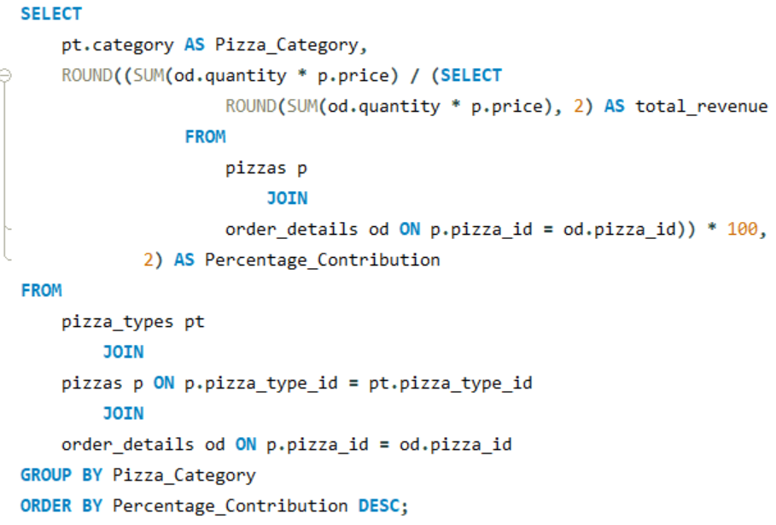
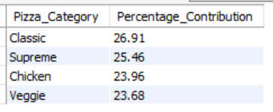
Calculate the percentage contribution of each pizza category to total revenue

Slide 17
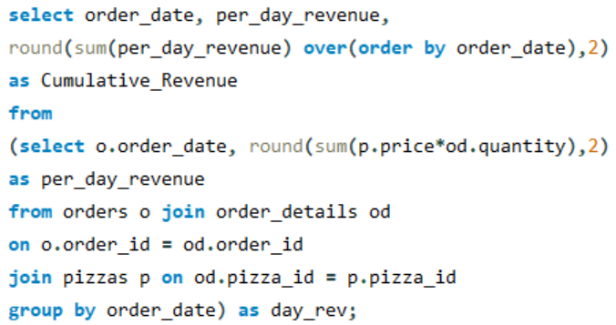
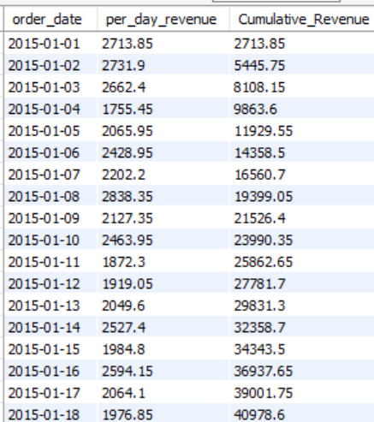
Analyze the cumulative revenue generated over time.

Slide 18
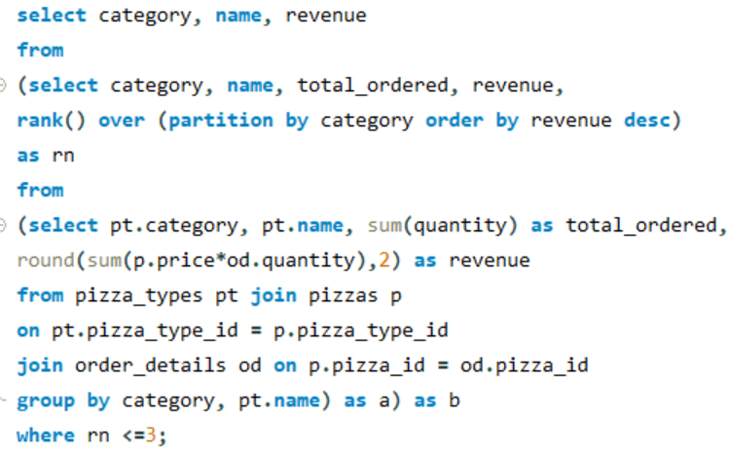
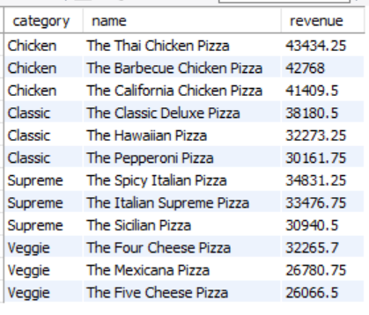
Determine the top 3 most ordered pizza types based on revenue for each pizza category.

Slide 19
For more details of this project, Click here to navigate to my GitHub portfolio

Slide 20
Thank you !

